Slide 1

Preface.
Preface
All Business Processes of other modules result in financial
Implications. You must remember that almost everything else that other modules do, affects FI/CO, and sometimes they don’t know it. Thus FI / CO is the base of all other SAP applications. It takes inputs from other modules and generates MIS & External Reports

Slide 2
Let’s cover this session in following steps :
1) Organizational structure of FI
2) Interface of FI with Other modules
3) FI and SD Business processes
4) FI and MM Business processes
5) FI and Inventory Movements
6) FI and its sub modules.
7) Accounting Processes in FI

Slide 3
STEP No.1
Organizational structure of FI

Slide 4
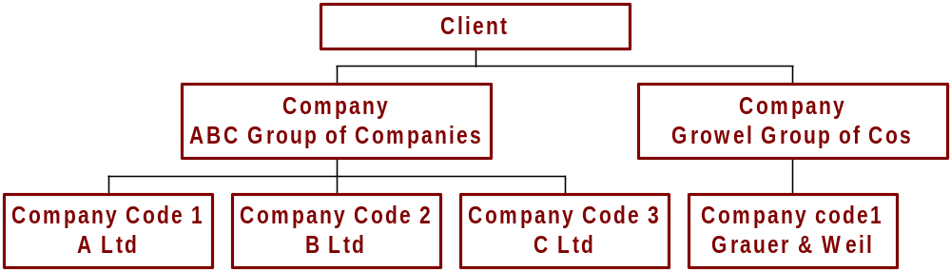
FI – Organizational Chart
FI - Organizational Chart
(A Graphical Representation )
Business Area 1
Business Area 2
Business Area 3

Slide 5
FI – Organizational Chart
FI - Organizational Chart
Client :
It is a self contained unit in R/3 system, with separate master records and its own set of tables
Thus Client is a logical system or a self contained technical entity.
Company :
It is a unit that represents a Business Organization according to
requirements of commercial laws.
It may be a single legal entity or group of several legal entities.
Consolidation in SAP is based on COMPANY.

Slide 6
FI – Organizational Chart……..
FI – Organizational Chart ………
Company Code :
This is not a code of a company, but a separate level in Orgn Chart.
Company code is used to structure the organization from Accounting Perspective.
This is the organizational unit for which separate Balance Sheet And Profit & Loss Account can be prepared.
As a rule it represents legally independent company (i.e.company defined as per The Companies Act ) but it can also be legally dependent units based abroad, if there are separate external reporting requirements
Full advantage of SAP System Integration can be taken by linking company code to organizational units of other applications. E.g. Purchase Orgn of MM, Sales Orgn of SD.

Slide 7
FI – Organizational Chart……..
Business Area.:
Business areas are primarily used to facilitate external segment reporting across company codes, covering the company's main areas of operation (e.g. product lines, branches).
You can assign all balance sheet items, such as fixed assets, receivables, payables and material stock, as well as the entire P&L statement directly to business areas. You can only assign banks, equity, and taxes manually to business areas if you do this indirectly. For this reason, it is not possible to create the legally-required financial statements and tax reports at business area level. Financial statements at business area level are therefore only suitable for use in internal reporting.

Slide 8
Organizational Structure of Growel Group
Client
Company Code
Company
Growel Group of Companies
Company
Growel Softech Ltd.
Grauer & Weil (I) Ltd
Digikore Studios Ltd
Vapi
Plant
Pune
Plant
Kandiwali
Plant
Barotiwala
Plant
Business Area

Slide 9
STEP No. 2
Interface of FI with Other Modules

Slide 10
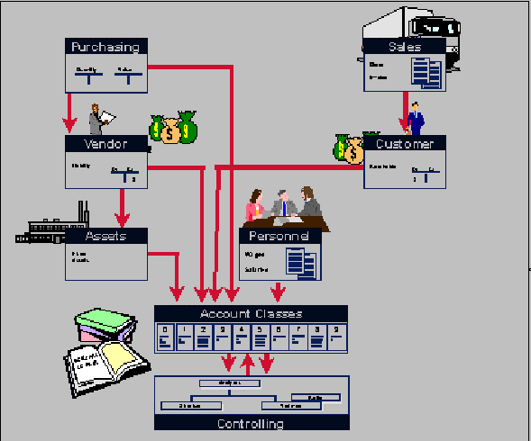
Relation of FI with other modules
Purchasing
Sales
Vendor
Customer
Assets
Personnel
Financial Accounting
Controlling

Slide 11
FI / Co interface
The FI/CO interface is the central interface for transferring postings from other application components in the SAP R/3 System to Accounting.
The FI/CO interface controls updates of actual data in Accounting and carries out checks from the Accounting standpoint.
Actual data relevant to Accounting from other SAP R/3 application components is first transferred to the FI/CO interface. The FI/CO interface then sends the data to the appropriate Accounting application component (such as Asset Management, Financial Accounting, Cost Center Accounting, Profit Center Accounting, Profitability Analysis, and so on).

Slide 12
FI / Co interface ……
For example :
Billing data from the
Materials Managements (MM)
FI/CO interface
the relevant Accounting documents are created
CO document
FI document
Asset document

Slide 13
Thus Data Flow from different applications to FI and CO is like this.

Slide 14
STEP No. 3
FI and SD Business Processes

Slide 15
FI and SD Relationship :
FI and SD are basically related for customer, sales and movement
of stocks. FI data gets updated with the flow of SD……in some cases through Automatic A/c Assignment or through pure financial transactions e.g. advance receipts, rent receipts.
Otherwise:
Automatic Account Assignment is the process through which
General Ledger and Customer accounts are linked to SD in such a
way that these A/cs are updated automatically with the transactions
in SD. Thus we need not pass any entries in FI, for those Transactions.
Account Key plays a major role in this Account determination
Lets see what is the flow (or Business Process ) of SD and how
FI is affected at the every stage of the flow.

Slide 16
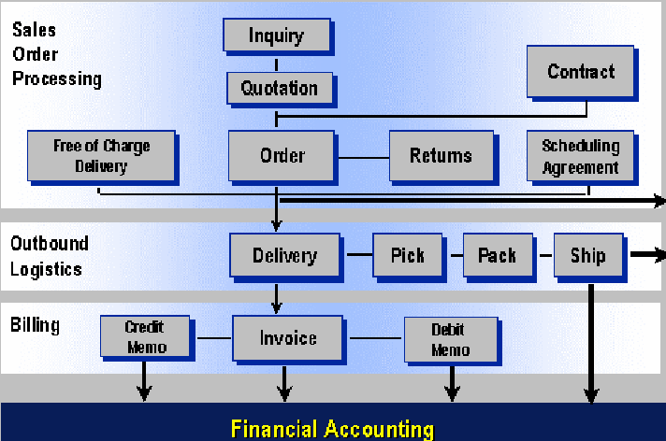
:Accounting processes in relation to
SD Work flow :
Order

Slide 17
Sales Order creation has no effect in FI or CO, but the cognizance
is taken in future fund flow & cash flow. And budgeting exercise
( Presently not implemented.)

Slide 18
Accounting processes in relation to
SD Work flow :
Delivery

Slide 19
Delivery / Dispatch :
Finished Goods Inventory is reduced. And the cost of sold material
is booked to Cost of Goods sold A/c. (Mvt Type. 601)
The entry passed for the transaction is -
Cost of Goods Sold A/c………Debit.
To Finished goods Inventory A/c

Slide 20
:Accounting processes in relation to
SD Work flow :
Invoice

Slide 21
Raising of Invoice :
Sales is recognized at this point. The liability for excise and sales tax collected is booked and customers out standings are increased. The entry passed is –
Customers A/c………….Debit
      To Sales A/c.
      To Excise Collected.A/c
      To Sales Tax Collected A/c.

Slide 22
Accounting processes in relation to
SD Work flow :
Credit
Memo
Debit
Memo

Slide 23
Credit / Debit Memo :
Sometime customer A/c needs to be adjusted because of difference in
quantity delivered or calculation mistake in taxes, discounts etc.
In such situations customer’s balance is reduced or increased as the
Case may be.
Lets take for example that additional discount was given to him.
In this case his balance will be reduced and discount will be charged
To Profit & Loss A/c as expense. The entry passed will be –
Discount A/c………..Debit
To Customer’s A/c

Slide 24
Accounting processes in relation to
SD Work flow :
Free of Charge
Delivery

Slide 25
Goods Distributed as free sample :
Advertisement or Free Sample expenses or material replacement are
booked and Finished Goods stock is reduced to that extent.
The entry passed is –
Advertisement / Free Sample A/c ……….Debit
To Finished Goods Inventory.

Slide 26
Advance Received or Recovery from the customer:
The receipt of money is a purely financial transaction for Which Bank A/c will be debited and Customer’s A/c will be credited.

Slide 27
STEP No. 4
FI and MM Business Processes

Slide 28
FI and MM Relationship :
FI and MM are basically related for vendors, purchases and related movement of stocks. FI data gets updated with the flow of MM……in some cases through Automatic A/c Assignment and through pure financial transactions Otherwise.
Automatic Account Assignment is the process through which
General Ledger and Vendor Accounts are linked to MM in such a
way that these A/cs are updated automatically with the transactions
in MM. Thus we needn’t pass entries manually in FI . Valuation
Class & Movement Types play major role in this A/c determination.
Let’s see what is the flow (or Business Process ) of MM and how
FI is affected at the every stage of the flow.

Slide 29
Accounting Processes &
MM Business Cycle
Purchase Requisition
RFQ / Quotation
Purchase Order
Advance
Payment
Purchase Order
Goods Receipt
MODVAT
Capture
Bills from
Suppliers
Invoice Verification
Vendor Payment

Slide 30
Order :
No effect in FI or CO, but the cognizance is taken in future fund
flow & cash flow and budgeting exercise ( Presently not
implemented.)

Slide 31
Accounting Processes &
MM Business Cycle
Purchase Requisition
RFQ / Quotation
Purchase Order
Advance
Payment
Goods Receipt
Goods Receipts
MODVAT
Capture
Bills from
Suppliers
Invoice Verification
Vendor Payment

Slide 32
Goods Receipt : (Movement Type 101)
Inward movement of goods increases the stock of material. But since
The invoice is not received, some intermediary A/c is credited.
The A/c entry passed here is –
Material Procured A/c …….Debit. (RM, Tools, Consum.etc.)
To GR / IR A/c…… (Intermediary A/c)

Slide 33
Accounting Processes &
MM Business Cycle
Purchase Requisition
RFQ / Quotation
Purchase Order
Advance
Payment
Goods Receipt
MODVAT
Capture
MODVAT
Capture
Bills from
Suppliers
Invoice Verification
Vendor Payment

Slide 34
MODVAT Capture : (Transactions J1IA, J1IB)
Excise details of procured material are verified and entered by the
Purchase Dept. Here MODVAT Credit availed, by passing an entry -
MODVAT RG23A Part II A/c……….Debit
To MODVAT Clearing A/c

Slide 35
Accounting Processes &
MM Business Cycle
Purchase Requisition
RFQ / Quotation
Purchase Order
Advance
Payment
Goods Receipt
MODVAT
Capture
Bills from
Suppliers
Invoice Verification
Invoice Verification
Vendor Payment

Slide 36
Invoice Verification :
When accounts copy of the Invoice is received, it is verified by
Purchase Dept. At this stage Vendor’s outstanding balance is
increased and intermediary A/c Created at the time of Goods Receipt
is nullified. The entry passed is –
GR / IR A/c ………..Debit (Intermediary A/c )
MODVAT Clearing A/c ………Debit (Intermediary A/c)
To Vendor’s A/c

Slide 37
Credit / Debit Memo :
Sometime Vendor’s A/c needs to be adjusted because of difference
in quantity delivered or calculation mistake in taxes, discounts etc.
In such situations Vendor’s balance is reduced or increased as the
Case may be.
Lets take for example that additional discount was given to Us.
In this case Vendor’s balance will be reduced and discount will be
recognized to Profit & Loss A/c as income. The entry passed will be
Vendor’s A/c ………Debit
To Discount Received A/c.

Slide 38
Accounting Processes &
MM Business Cycle
Purchase Requisition
RFQ / Quotation
Purchase Order
Advance
Payment
Goods Receipt
MODVAT
Capture
Bills from
Suppliers
Invoice Verification
Vendor Payment
Vendor Payment

Slide 39
Advance or final payment to vendors.
The payment of money is a purely financial transaction for Which Bank A/c will be credited and Vendor’s A/c will be Debited.

Slide 40
Let’s study one transaction cycle to understand to accounting
implications.
For qty. ordered 10 units,
Price as per PO.
Basic price Rs.100
Excise Duty (20% ) Rs. 20
Sales Tax (15% ) Rs. 18
MODVAT benefit is
available for full amt of Excise
Sales tax set off is @ 10%
So you will get total modvat
benefit of Rs.200
And sales tax set off of Rs. 120
Total Price / unit 138
Total material value 1380
All the data is imaginary.
And tax rates, easy for calculation.

Slide 41
Let’s study one transaction cycle to understand to accounting
implications.
Goods Received against PO.
Price as per PO.
Basic price Rs.100
Excise Duty (20% ) Rs. 20
Sales Tax (15% ) Rs. 18
MODVAT benefit is
available for full amt of Excise
Sales tax set off is @ 10%
So you will get total modvat
benefit of Rs.200
And sales tax set off of Rs. 120
Total Price / unit 138
Total material value 1380

Slide 42
RM. Stock A/c (current Assets)
RM Consumed (Exps A/c)
1060
Excise Duty
(MODVAT ) A/c
GR/IR A/c
Sales Tax set off A/c
1180
120

Slide 43
Let’s study one transaction cycle to understand to accounting
implications.
Modvat Captured
Price as per PO.
Basic price Rs.100
Excise Duty (20% ) Rs. 20
Sales Tax (15% ) Rs. 18
MODVAT benefit is
available for full amt of Excise
Sales tax set off is @ 10%
So you will get total modvat
benefit of Rs.200
And sales tax set off of Rs. 120
Total Price / unit 138
Total material value 1380

Slide 44
RM. Stock A/c (C/Assets)
RM Consumed (Exps A/c)
Modvat Clearing
1060
200
Excise Duty
(MODVAT ) A/c
GR/IR A/c
Sales Tax set off A/c
1180
120
200

Slide 45
Let’s study one transaction cycle to understand to accounting
implications.
Invoice Verification
Price as per PO.
Basic price Rs.100
Excise Duty (20% ) Rs. 20
Sales Tax (15% ) Rs. 18
MODVAT benefit is
available for full amt of Excise
Sales tax set off is @ 10%
So you will get total modvat
benefit of Rs.200
And sales tax set off of Rs. 120
Total Price / unit 138
Total material value 1380

Slide 46
RM. Stock A/c (C/Assets)
RM Consumed (Exps A/c)
Modvat Clearing
1060
200
200
Excise Duty
(MODVAT ) A/c
GR/IR A/c
Sales Tax set off A/c
1180
1180
120
200
Credit goes to vendor A/c
for Rs.1380. (total Ivn. Amt.)

Slide 47
Let’s study one transaction cycle to understand to accounting
implications.
Issued for Production
Say 5 items were issued
Price as per PO.
Basic price Rs.100
Excise Duty (20% ) Rs. 20
Sales Tax (15% ) Rs. 18
MODVAT benefit is
available for full amt of Excise
Sales tax set off is @ 10%
So you will get total modvat
benefit of Rs.200
And sales tax set off of Rs. 120
Total Price / unit 138
Total material value 1380

Slide 48
RM. Stock A/c (C/Assets)
RM Consumed (Exps A/c)
Modvat Clearing
1060
530
530
200
200
Excise Duty
(MODVAT ) A/c
GR/IR A/c
Sales Tax set off A/c
1180
1180
120
200
Goods are issued at
moving average price

Slide 49
Let’s study one transaction cycle to understand to accounting
implications.
Invoice Verification – Rs.100 extra charged as Pck & Fwd
Price as per PO.
Basic price Rs.100
Excise Duty (20% ) Rs. 20
Sales Tax (15% ) Rs. 18
MODVAT benefit is
available for full amt of Excise
Sales tax set off is @ 10%
So you will get total modvat
benefit of Rs.200
And sales tax set off of Rs. 120
Total Price / unit 138
Total material value 1380

Slide 50
RM. Stock A/c (C/Assets)
RM Consumed (Exps A/c)
Modvat Clearing
1060
200
200
This calculation depends on
tax code.So wrong selection
of tax code results in wrong
valuation of R.M.
91
Excise Duty
(MODVAT ) A/c
GR/IR A/c
Sales Tax set off A/c
1180
1180
120
200
9
Here system calculated ST on Rs.100
by backward method. Out of total ST
of Rs.13, Rs. 9 were allowed as set off
Credit goes to vendor A/c
for Rs.1480. (total Ivn. Amt.)

Slide 51
Let’s study one transaction cycle to understand to accounting
implications.
Issued for Production
Say 5 items were issued
Price as per PO.
Basic price Rs.100
Excise Duty (20% ) Rs. 20
Sales Tax (15% ) Rs. 18
MODVAT benefit is
available for full amt of Excise
Sales tax set off is @ 10%
So you will get total modvat
benefit of Rs.200
And sales tax set off of Rs. 120
Total Price / unit 138
Total material value 1380

Slide 52
RM. Stock A/c (C/Assets)
RM Consumed (Exps A/c)
Modvat Clearing
1060
575
575
200
200
91
Excise Duty
(MODVAT ) A/c
GR/IR A/c
Sales Tax set off A/c
1180
1180
120
200
9

Slide 53
Similar treatment is given for ‘Sub-sequent Debits’ entered in MM.
Thus these adjustments affect the material value. And the cost of
production by implication.
So while entering tax codes or sub-sequent debits you must be alert.

Slide 54
Material Rejections And Documents Reversals:-
SAP Standard Process Flow
G & W Process Flow
MODVAT Capture
Inspection
GRN
GRN
Inspection
MODVAT Capture
Invoice Verifin/ (Material Issue)
Invoice Verifin / (Material Issue)
Material Issue
Material Issue

Slide 55
Material Rejection can be at various stages ……..
Inspection stage.
When it is issued for production (After invoice verification)
When it is issued for production (Before invoice verification)
Inspection stage.
When material is rejected at Inspection stage, you have to reverse
MODVAT Credit and Goods Receipt.
But in our case, since inspection is made before GRN is made and
before MODVAT is captured, there is no need to reverse any document

Slide 56
Material Rejection can be at various stages ……..
Inspection stage.
When it is issued for production (After invoice verification)
When it is issued for production (Before invoice verification)
When it is issued for production (After invoice verification)
When material is rejected after it was issued to production , then you have to reverse the the whole cycle.
The accounting effects will be as follows…..

Slide 57
RM. Stock A/c (C/Assets)
RM Consumed (Exps A/c)
Modvat Clearing
1060
530
530
530
200
200
530
Excise Duty
(MODVAT ) A/c
GR/IR A/c
Sales Tax set off A/c
1180
1180
120
200
Reversal of Issue

Slide 58
Like this all the original entries are reversed.
The system dose not delete original entries at the time of reversal,
but passes another entry which nullifies the effects of original entry.
Similarly when material is rejected before Invoice Verification, other
Documents, viz. Material issue, GRN and MODVAT Capture have to
be reversed.

Slide 59
Reason for Document Reversal :
Rejection of material
Wrong Entry of Excise Group in GRN or Modvat Capture.
While changing the previous document.
Remember….
If material is issued to production, and because of some problems,
you want to reverse GRN, then you have to see that there is enough
stock in stores. Otherwise system will not allow reversal.
To avoid these complications, try to avoid the Reversals.

Slide 60
STEP No.5
FI and Inventory Movements

Slide 61
FI and Inventory Movements:
Movement in material changes the quantity, and in some cases the value of it. These are called quantity updates and value updates respectively. For every Movement type, that affects the value update, an Accounting Document is generated by the system. Ledger Accounts are linked to movement types. And through this link, G/L A/c s are automatically updated with the value update in materials.
Change in storage location, issue of material for sub contracting are
some movements where only quantity is updated. While, Issue of
Goods for production, Deterioration in quality, scraping of material
are the movements where quantity and value both are changed.
Let’s understand how movement types are linked to FI, with the help of an example.

Slide 62
Link of FI and Flow of Material
1
Procurement of material
RM Procurement (Current Assets) A/c
(Mvt type 101 )
20000
2
Issued to Production
Mvt. type 261
3
Month end Closing
(Valuation of WIP )
4
Opening of new month
Vendors A/c
(Reversal of WIP)
20000
5
Production Complete
(Mvt type 101 )
(Finished Goods ready)
6
Sales of Finished Goods
Mvt. type 601
Raw material procured is initially
Treated as Current Assets

Slide 63
Link of FI and Flow of Material
1
Procurement of material
RM Procurement (Current Assets) A/c
(Mvt type 101 )
20000
10000
2
Issued to Production
Mvt. type 261
3
Month end Closing
(Valuation of WIP )
4
Opening of new month
Raw Material Consumed A/c (P & L A/c)
(Reversal of WIP)
10000
5
Production Complete
(Mvt type 101 )
(Finished Goods ready)
6
Sales of Finished Goods
When Raw material is issued to Prod, it is treated as Expenses.
Mvt. type 601

Slide 64
Link of FI and Flow of Material
Production is not complete here. But we are Making month end closing.
At this stage entry passed is -
1
Procurement of material
(Mvt type 101 )
WIP A/c (Current Assets)
2
Issued to Production
Mvt. type 261
10000
3
Month end Closing
(Valuation of WIP )
Profit and Loss A/c
4
Opening of new month
(Reversal of WIP)
10000
5
Production Complete
(Mvt type 101 )
(Finished Goods ready)
WIP A/c is created and separate entry is made to P & L A/c to off set the debit booked to RM consumed A/c.
6
Sales of Finished Goods
Mvt. type 601

Slide 65
Link of FI and Flow of Material
Here we reverse the entry passed in the last stage., so we come back to situation of stage 2
1
Procurement of material
(Mvt type 101 )
Raw Material Purchase A/c (Current Assets)
2
Issued to Production
Mvt. type 261
20000
10000
3
Month end Closing
(Valuation of WIP )
RM Consumed A/c (P&L A/c)
4
Opening of new month
(Reversal of WIP)
10000
5
Production Complete
(Mvt type 101 )
(Finished Goods ready)
6
Sales of Finished Goods
Mvt. type 601

Slide 66
Link of FI and Flow of Material
1
Procurement of material
(Mvt type 101 )
Finished Goods A/c (Current Assets)
2
Issued to Production
Mvt. type 261
10000
3
Month end Closing
(Valuation of WIP )
Factory Output (P&L A/c)
4
Opening of new month
(Reversal of WIP)
10000
5
Production Complete
(Mvt type 101 )
Finished Goods ready
Production Process is complete. So
Finished Goods stock is created and
RM Consumed A/c is off set.by credit
Entry to Factory output A/c
6
Sales of Finished Goods
Mvt. type 601

Slide 67
Link of FI and Flow of Material
1
Procurement of material
(Mvt type 101 )
Finished Goods A/c (Current Assets)
2
Issued to Production
Mvt. type 261
10000
10000
3
Month end Closing
(Valuation of WIP )
Cost of Goods Sold (P&L A/c)
4
Opening of new month
(Reversal of WIP)
10000
5
Production Complete
(Mvt type 101 )
Finished Goods ready)
6
Sales of Finished Goods
Mvt. type 601

Slide 68
STEP No. 6
FI and its Sub-modules

Slide 69
Internal Structure of FI
FI works through its sub-modules viz.
General Ledger
Accounts Payables (Vendors )
Accounts Receivables (Customers)
Assets
Controlling
In accounting terminologies, all accounts are General Accounts.
But in SAP, considering the separate requirements of data and for
convenience purpose, Customers, Vendors and Assets accounts
are dealt with through respective sub modules. Rest of the
Accounts (other than Vendors, Customers and assets ) are covered in General Ledger Accounts. And these sub-modules are linked to
Genera Ledger.

Slide 70
Internal Structure of FI……
Final accounts for external reporting i.e.Balance Sheet and Profit and Loss A/c are prepared From General Ledger.
Since SAP record Vendors, Customers and Assets A/cs in separate
Sub-modules, it is required to transfer those balances to General
Ledger.
Reconciliation Accounts serves this purpose. AR, AP & Assets
sub-modules are linked to GL thorough these Accounts.
These Reconciliation A/cs are very much similar to what we used to call as Total Customers A/c or Total Vendors A/c in our manual system of book keeping.

Slide 71
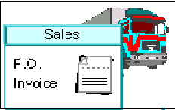
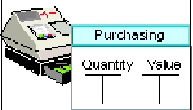
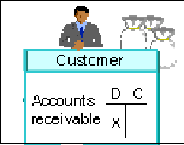
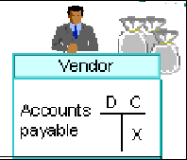

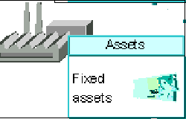
Graphical Representation
G
E
N
E
R
A
L
L
E
D
G
E
R
Recon
A/c
Recon.
A/c
Recon.
A/c
Balance Sheet And Profit & Loss Account

Slide 72
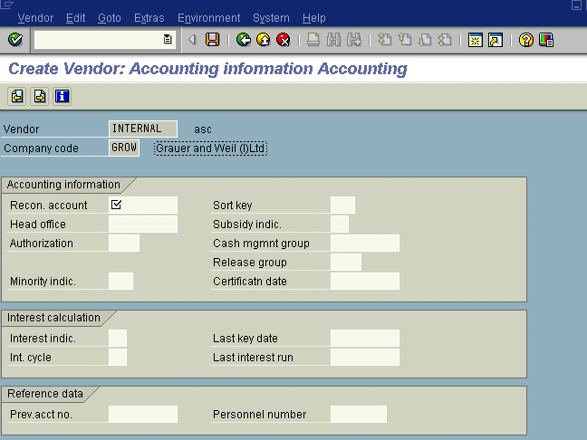
Reconciliation Accounts for Vendors and Customers.
Reconciliation Account, itself is a GL A/c
Normally separate Reconciliation Accounts are used for different
types of vendors or customers. e.g. there are separate Recon A/c
for Domestic Vendor, Foreign Vendors, Employees’ Account etc.
And Vendor or Customer accounts are linked to these Recon A/c at the time of creating Vendor or Customer Master

Slide 73
STEP No. 7
Accounting Processes in FI

Slide 74
Typical Transaction in covered in FI
Creating Master Record
Payment to Vendors - Receipts from Customers.
Booking of Expenses.
Special Transactions.
Cash Journal.

Slide 75
The account group determines the fields for the A/c creation entry screens. It also determines number interval in which the A/c number will lie
1
Creating Master Records
Creating General Ledger (FS00)
Important Fields.
By selecting this indicator you tell the system, whether it’s a B/S A/c or P&L A/c.
The G/L account number identifies the G/L account in a chart of accounts. At the creation of new A/c system allocates this number
Field status group determines the screen layout at the entry of document when entering in that particular account.
GL A/c Number.
Account Group.
Account currency indicates the currency in which this account is held.
If a currency other than the company code is specified, users can only post items in that currency to this account.
If the company code currency is specified, users can post items in any currency to this account.
Balance Sheet or Profit and loss
Account text
Short and long description or name of the account.
Account Currency
Field status group

Slide 76
1
Creating Master Records………
Creating Vendor / Customer A/c (FK01 /FD01)
Vendors and Customers A/c are normally maintained by MM and SD Peoples respectively. But for some expenses or services like, Elec.Bill, Consultant’s Fees etc., vendors’ A/c are defined in FI. Besides, if HR module is not implemented, employees are treated as vendors
Important Fields
A/c Number.
Account Number
Account Group .
Name & Address
Reconciliation Account
Withholding Tax Data

Slide 77
Account Number (Vendor Code)
Vendor is identified in SAP by the unique number given to the vendor called as vendor code.
This number may be allotted manually or automatically by the system, depending on A/c group.
In automatic numbering, system gives the sequential number to the newly created account.
In manual numbering, the user has to give the number to vendor A/c. This can be any number within the specified range for that type of vendors.
So while allotting the number manually user must be very alert. He must keep the track of number range. While creating new A/c , he must refer to the last created A/c and use the next sequential number.
In our case, Employee A/c have to be numbered manually.

Slide 78
1
Creating Master Records………
Creating Vendor / Customer A/c (FK01 /FD01)
Vendors and Customers A/c are normally maintained by MM and SD Peoples respectively. But for some expenses or services like, Elec.Bill, Consultant’s Fees etc., vendors’ A/c are defined in FI. Besides, if HR module is not implemented, employees are treated as vendors
Important Fields
A/c Number.
Account Group .
Account Group
Name & Address
Reconciliation Account
Withholding Tax Data

Slide 79
Vendor account group
The account group is a classifying feature It determines:
o the number interval for the account number of the vendor,
o whether the number is assigned by the user or by the system,
o which specifications are necessary and/or possible in the
master record. (Field Status of vendor account creation.)

Slide 80
1
Creating Master Records………
Creating Vendor / Customer A/c (FK01 /FD01)
Vendors and Customers A/c are normally maintained by MM and SD Peoples respectively. But for some expenses or services like, Elec.Bill, Consultant’s Fees etc., vendors’ A/c are defined in FI. Besides, if HR module is not implemented, employees are treated as vendors
Important Fields
A/c Number.
Put the name and detailed address of the Vendor or Customer
Account Group .
Name & Address
Name & Address
Reconciliation Account
Withholding Tax Data

Slide 81
1
Creating Master Records………
Creating Vendor / Customer A/c (FK01 /FD01)
Vendors and Customers A/c are normally maintained by MM and SD Users respectively. But for some expenses or services like, Elec.Bill, Consultant’s Fees etc., vendors’ A/c are defined in FI. Besides, if HR module is not implemented, employees are treated as vendors
Important Fields
A/c Number.
Account Group .
Name & Address
Reconciliation Account
Reconciliation Account
Withholding Tax Data

Slide 82
Reconciliation Account in General Ledger
The reconciliation account in G/L accounting is the account which is updated parallel to the sub ledger account for normal postings (for example, invoice or payment)
Currency of Vendor / Customer A/c is the currency of its Reconciliation A/c.

Slide 83
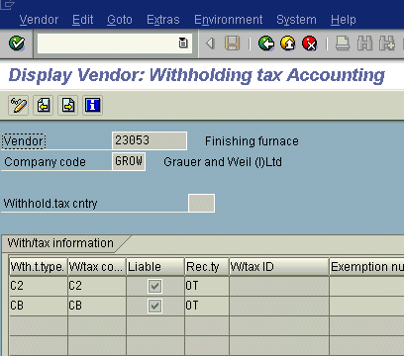
1
Creating Master Records………
Creating Vendor / Customer A/c (FK01 /FD01)
Vendors and Customers A/c are normally maintained by MM and SD Peoples respectively. But for some expenses or services like, Elec.Bill, Consultant’s Fees etc., vendors’ A/c are defined in FI. Besides, if HR module is not implemented, employees are treated as vendors
Important Fields
A/c Number.
Account Group.
Name & Address
Reconciliation Account
Withholding Tax Data
Withholding Tax Data

Slide 84
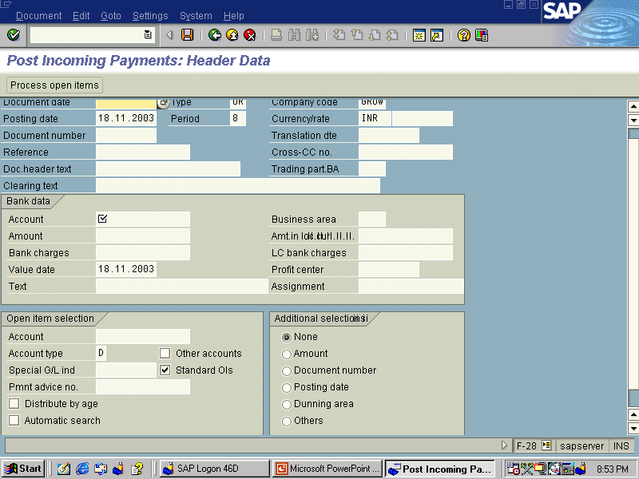
2
Payments And Receipts
Payment to Vendors is made through ‘Outgoing Payments’ (F-53)
Receipt from Customers is booked thr’ ‘Incoming Payment’ (F-28)
Important Points :
Put Document date, Reference, Bank A/c, Amount, Business Area, Vendors’ / Customers’ A/c.
Put proper Special G/L indicator, to see the open items generated from special transactions.
Select the proper open item that you want to set off against the payment / receipt.
You can make / accept partial payment. But in such a case, after total payment / receipt, you have to clear the open items separately (Vend: F-44 , Cust : F-32)
If not further payment / receipt is to be made against any particular open item, then make the entry through ‘Residual payment’

Slide 85
3
Booking of Expenses
Some regular expenses are booked through Vendor Invoice in FI
(FB60) like e.g. Rents, Consultation Fees, Telephone Bills etc.
Other expenses (normally for which party A/c need not be
maintained ) are booked by making an entry through F-02.
Posting Key 40 is used for debit and 50 for credit.
The same transaction code is used to passing a Journal Entry, if
any.

Slide 86
4
Special Transactions
Some transactions are treated as Special Transactions in SAP
Down Payments
Bill of Exchange
Bank Guarantees
Here we will cover ‘Down Payments made to Vendors’ to explain
the concept and treatment of Special Transactions.

Slide 87
Down Payments made to vendors…………
As explained earlier, Vendor Accounts are linked to General Ledger
through Reconciliation Accounts. Normally separate reconciliation
accounts are used for different types of vendors. When any invoice,
debit -credit memo or payment is booked to vendor’s account,
these reconciliation accounts are also updated simultaneously.
But in case of special transactions vendors accounts are linked to GL
through ‘Special General Ledgers’. So if you make any down
payment to a vendor, Special General Ledger’ is updated, along with
the vendor account.
Let’s see this with the help of an example.

Slide 88
Down Payments made to vendors…………
Transaction Flow
Down payment (Advance payment )made
Invoice received from vendor
Clearing down payment
Balance payment to vendor.
Down payment (Advance payment )made

Slide 89
Bank Account
Vendors Account
Purchase Account
10000
10000
Reconciliation Account
(For normal transactions)
Special Recon Account
(For special transactions)
10000

Slide 90
Down Payments made to vendors…………
Transaction Flow
Down payment (Advance payment )made
Invoice received from vendor
Clearing down payment
Balance payment to vendor.
Invoice received from vendor

Slide 91
Bank Account
Vendors Account
Purchase Account
10000
10000
25000
25000
Reconciliation Account
(For normal transactions)
Special Recon. Account
(For special transactions)
25000
10000

Slide 92
Down Payments made to vendors…………
Transaction Flow
Down payment (Advance payment )made
Invoice received from vendor
Clearing down payment
Balance payment to vendor.
Clearing down payment

Slide 93
Bank Account
Vendors Account
Purchase Account
10000
10000
25000
25000
10000
10000
Reconciliation Account
(For normal transactions)
Special Recon. Account
(For special transactions)
10000
25000
10000
10000
This is a very important step because
otherwise, Total Vendors’ balance
or Total Advance to Vendors shown in
the Balance Sheet will be wrong.

Slide 94
Down Payments made to vendors…………
Transaction Flow
Down payment (Advance payment )made
Invoice received from vendor
Clearing down payment
Balance payment to vendor.
Balance payment to vendor

Slide 95
Bank Account
Vendors Account
Purchase Account
10000
10000
25000
25000
15000
15000
Reconciliation Account
(For normal transactions)
Special Recon. Account
(For special transactions)
10000
25000
10000
10000
15000

Slide 96
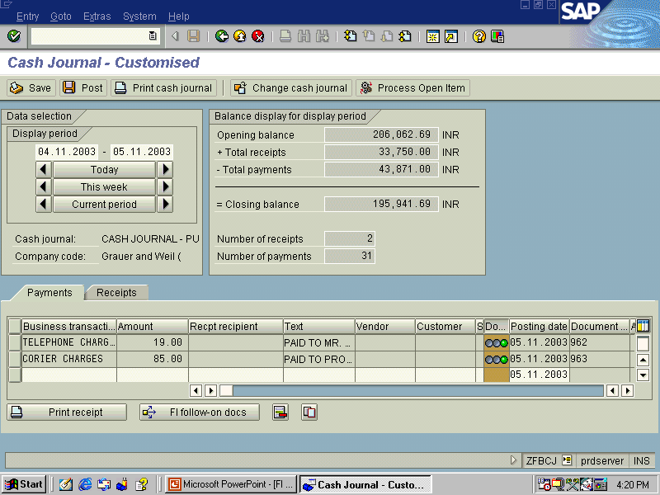
5
Cash Book
Day to day cash transactions are booked through Cash Book. In standard SAP, (Tr. code FBCJ.) Vendor and customers payments are not booked in Cash Book
But in our case, we have specially designed Cash Book, through which
we can book vendors and customers payments even by clearing it.
Transaction Code for this Cash Book is ZFBCJ.
While making entry you have
to select ----
Required screen (Recpt /pmt)
Transaction code (through which, expenses accounts are automatically posted.)
Amount of the transaction.

Slide 97
Thank You !

